Slide 1
School Management System
Presenter
Raihan Mahmud
ID: 161-35-1542
Department of SWE

Slide 2
Abstract
Project title: Smart School
Objective
This system provide facilities to store students/teachers info, notice board. Teachers, parents, school community and education bureau officials to view students/teachers info, notice board and know about school.

Slide 3
Main Features
Admin
Register
Add students
Search student for update/delete
Add teachers
Update/delete teacher
Publish notice
Delete notice
User
Home page
View students info
Search student
View teachers info
View notice board
About
Contact
Smart School

Slide 4
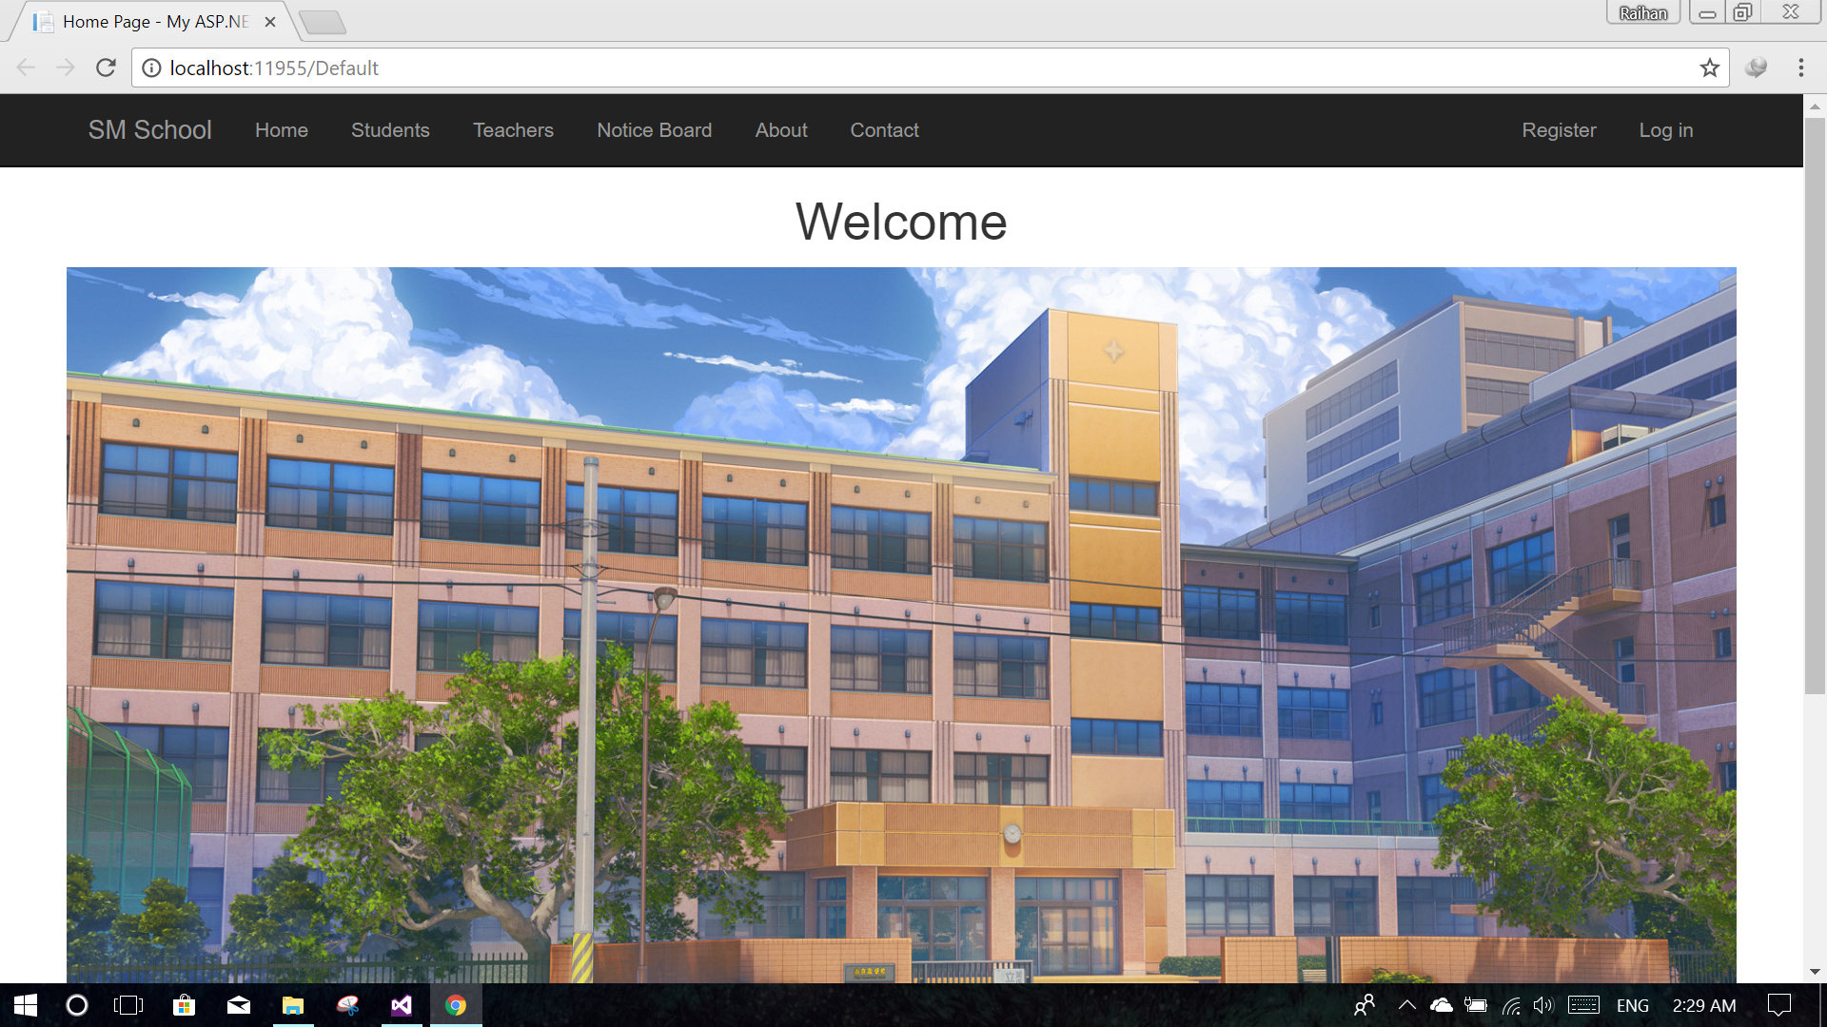
System Screen Shots
Home page:

Slide 5
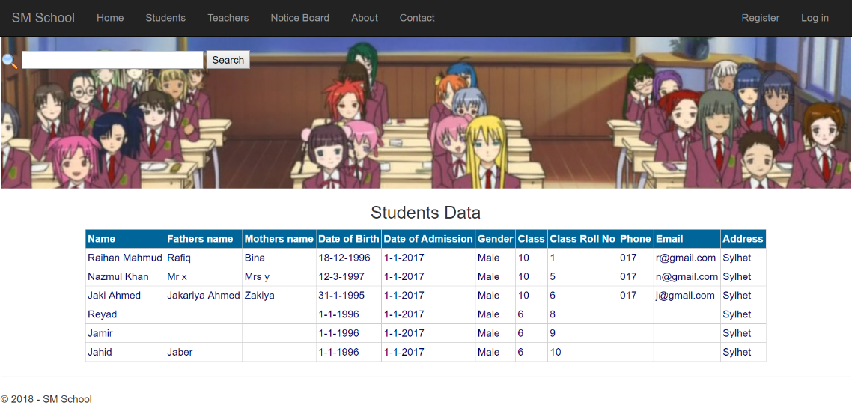
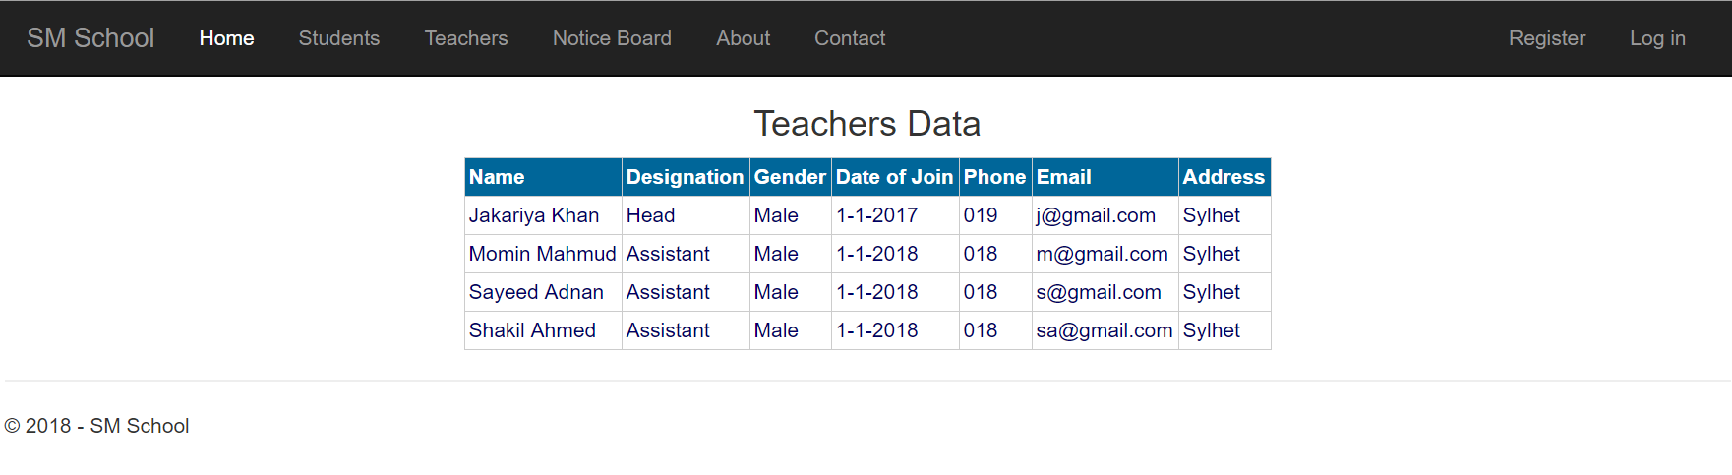
System Screen Shots
View students:
View teachers:

Slide 6
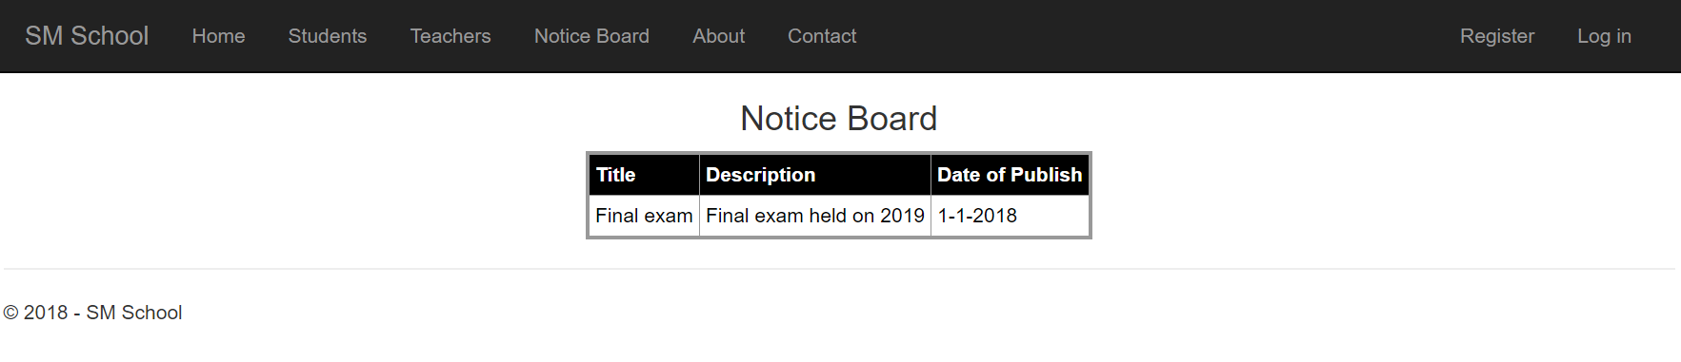
System Screen Shots
Notice board:

Slide 7
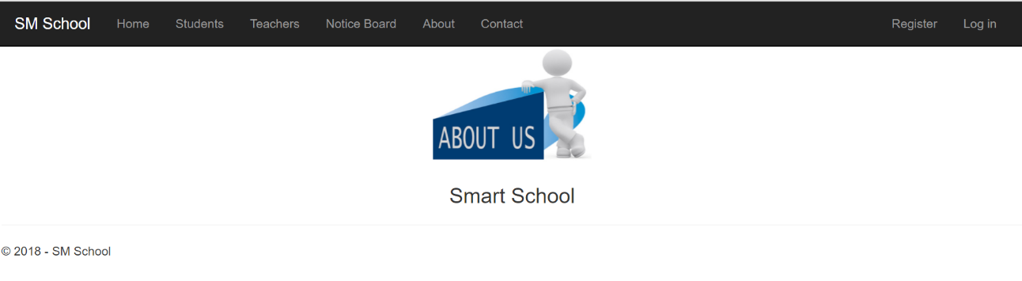
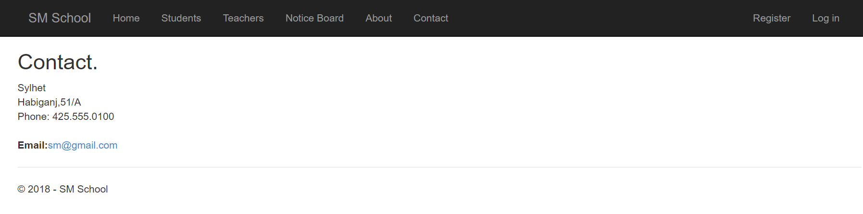
System Screen Shots
About:
Contact:

Slide 8
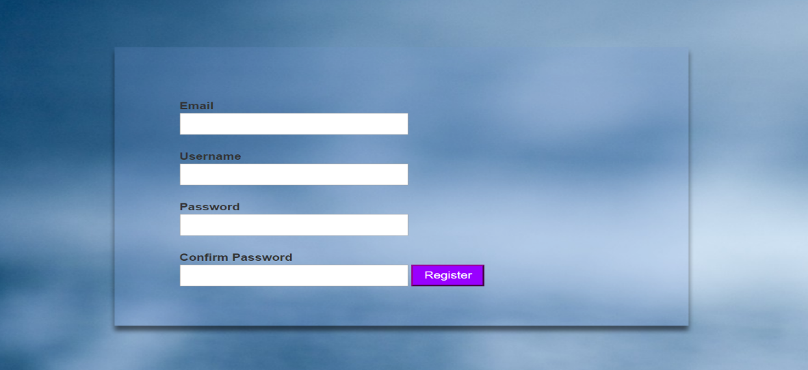
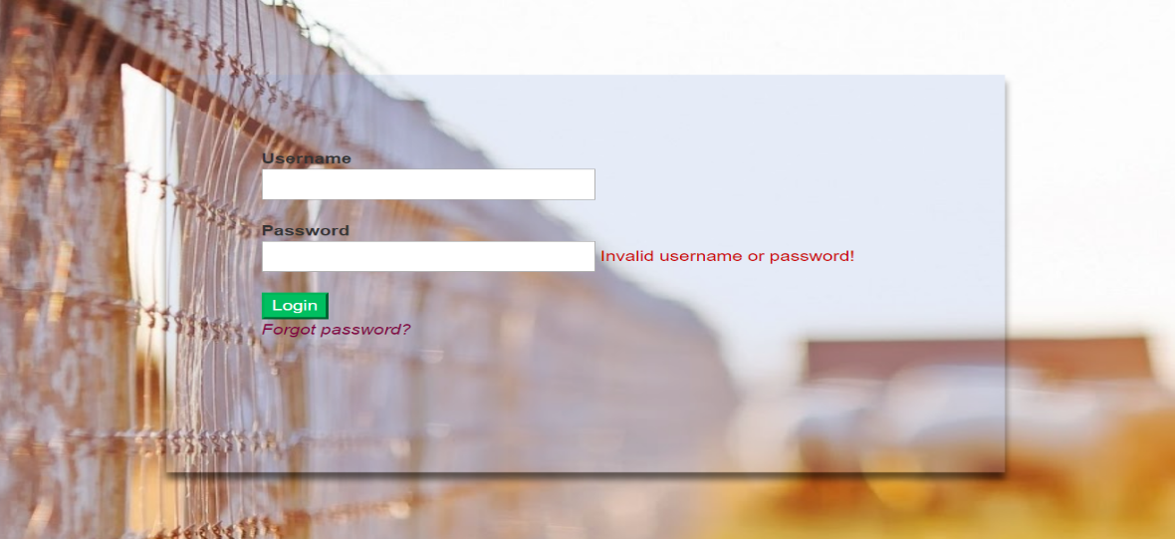
System Screen Shots
Register:
Login:

Slide 9
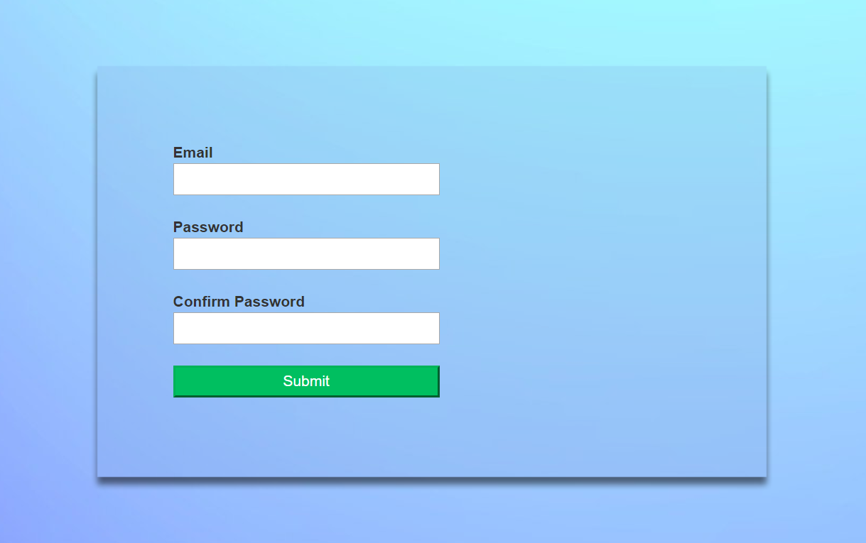
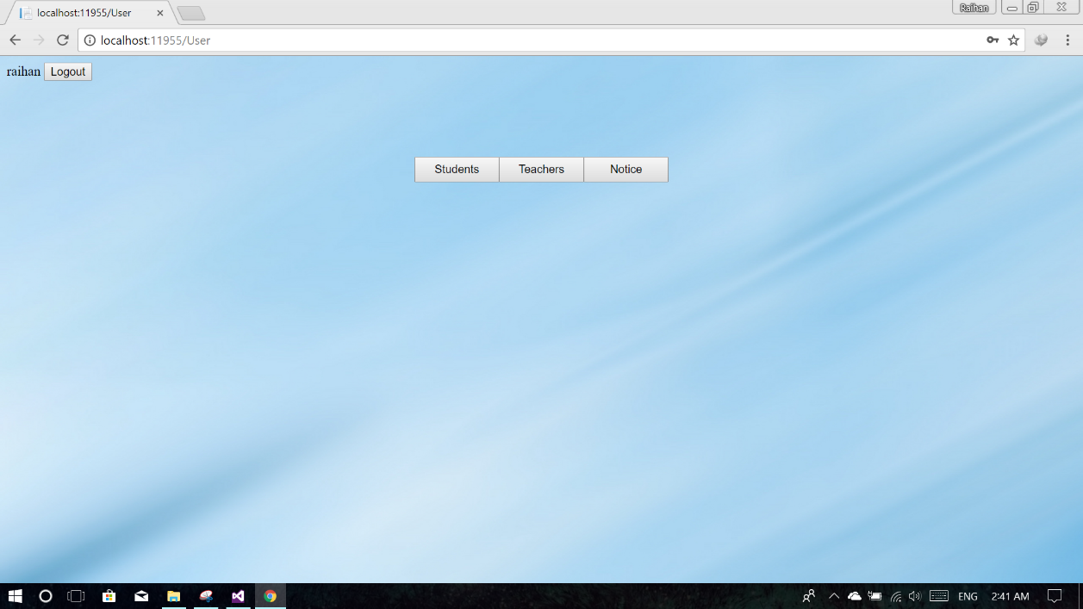
System Screen Shots
Forgot password:
Admin page:

Slide 10
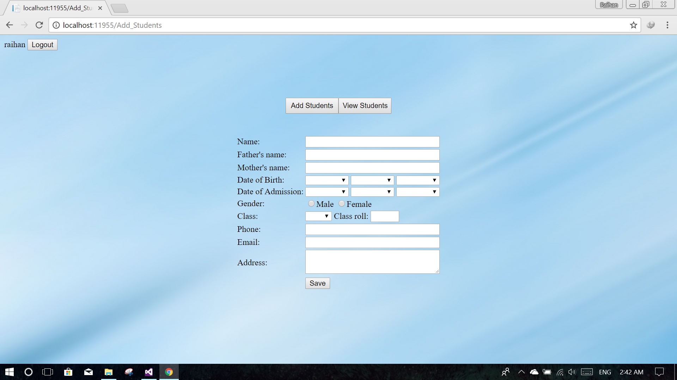
System Screen Shots
Add students:

Slide 11
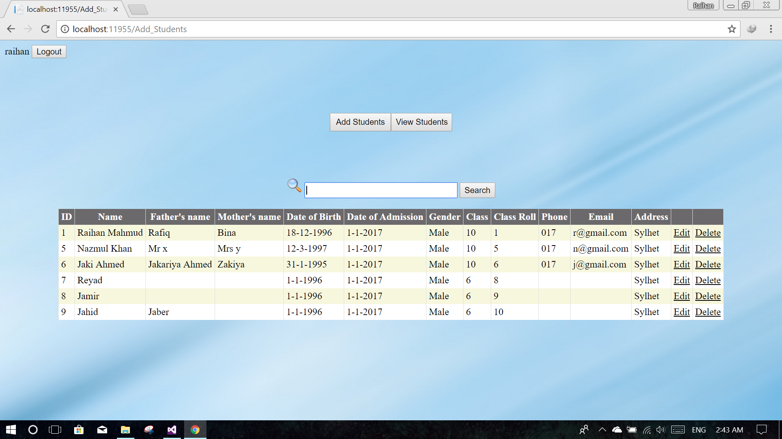
System Screen Shots
Search students for update/delete:

Slide 12
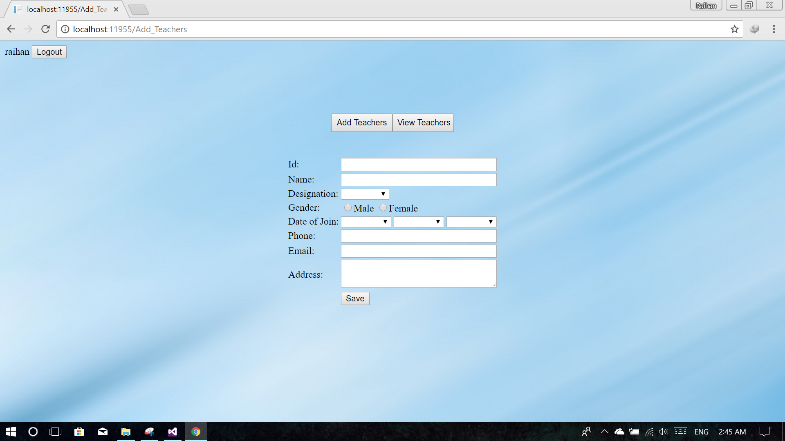
System Screen Shots
Add teachers:

Slide 13
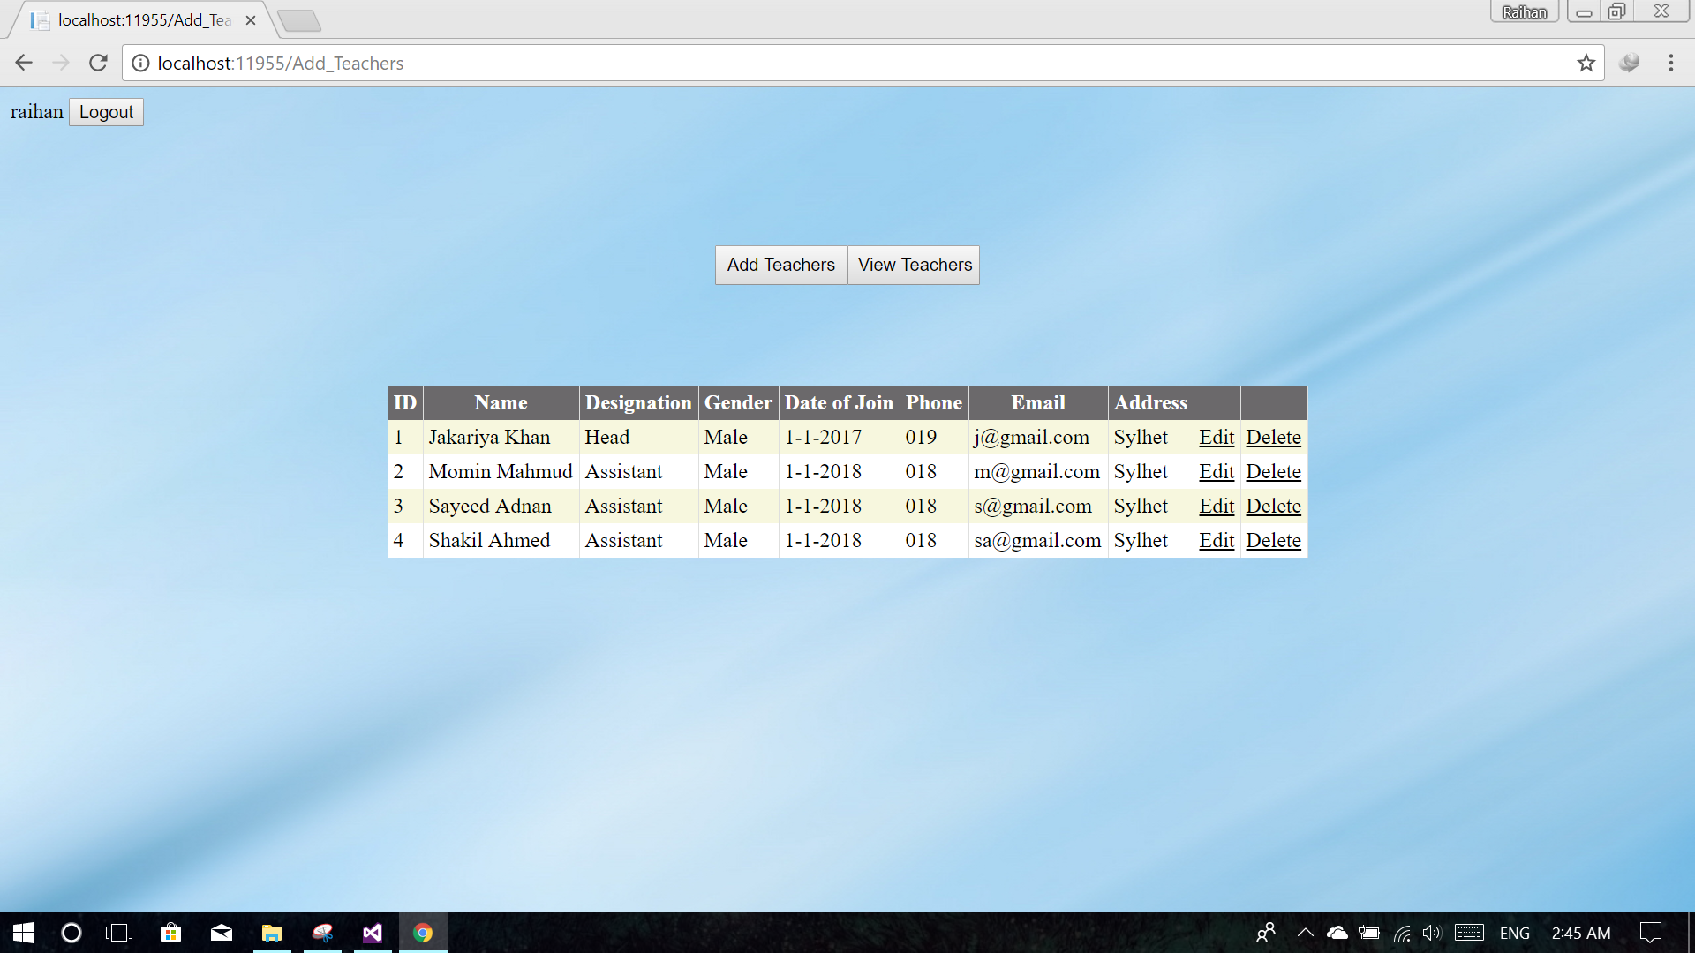
System Screen Shots
View teachers & update/delete:

Slide 14
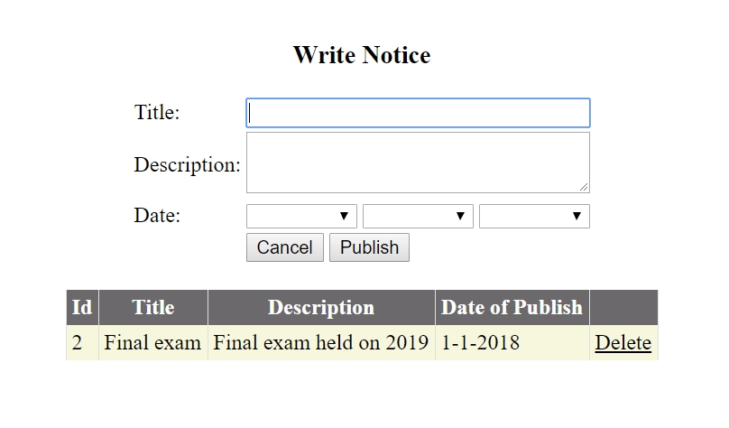
System Screen Shots
Publish notice/delete:

Slide 15

Thank you…

